Slide 1
Understanding Existing Standards:
NERC Critical Infrastructure Protection (CIP) Standards
Tobias Whitney, Principal, Critical Infrastructure Protection
March 21, 2018

Slide 2
Agenda
NERC overview
NERC mandatory CIP Reliability Standards
Current enforceable standards
Highlights of NERC CIP Version 5 (CIP V5)
Regulatory Developments
Additional NERC cybersecurity activity
Notes:
Purpose of Slide: Provide a roadmap of the talk.

Slide 3
NERC Mission
To ensure the reliability of the Bulk-Power System in North America
Develops and enforces Reliability Standards
Annually assesses seasonal and long-term reliability
Monitors the Bulk-Power System
Educates, trains, and certifies industry personnel
Subject to oversight by the Federal Energy Regulatory Commission in the United States
Designated by Department of Energy (DOE) as Electricity Sector Information Sharing and Analysis Center (ES-ISAC)
Notes:
Purpose of the slide: To quickly provide a snapshot of NERC’s cyber activities for the uninformed audience member who may be in a different industry.

Slide 4
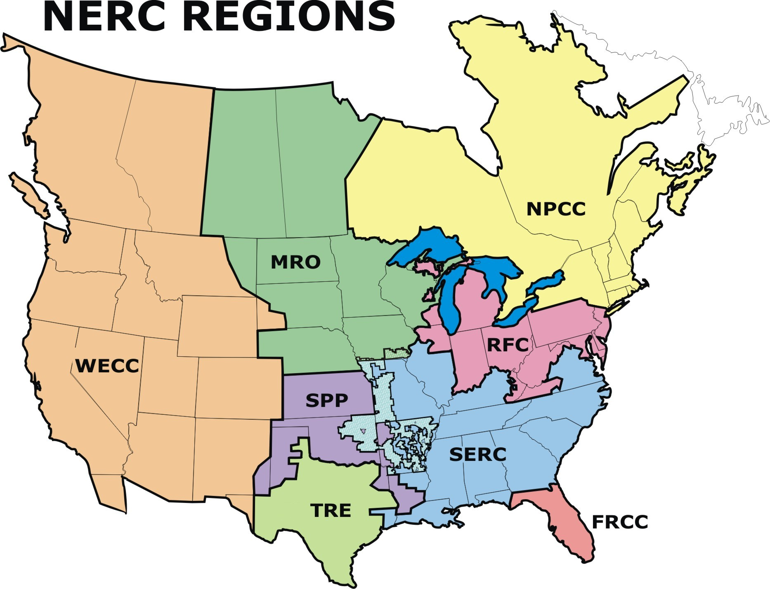
NERC Regions
Florida Reliability Coordinating Council
Midwest Reliability
Organization
Northeast Power
Coordinating Council
ReliabilityFirst Organization
SERC Reliability Corporation
Western Electricity Coordinating Council
Southwest Power
Pool RE
Florida Reliability
Coordinating Council
Texas Reliability Entity
Notes:
Purpose of slide: Everyone likes pictures – this shows the various regions and the size of the area (exlcuding Mexico) that NERC must account for in its approach to cyber security.

Slide 5
Reliability Standards
Define the reliability requirements for planning and operating the North American Bulk-Power System
Reflect a results-based approach that focuses on performance, risk management, and entity capabilities
Developed using an industry-driven American National Standards Institute (ANSI)-accredited process
CIP standards focus on cybersecurity and physical security of cyber assets
Notes:
Purpose of the slide: Introduce what our standards are, how they are developed, and what they protect.
NERC Reliability Standards define the reliability requirements for planning and operating the North American BPS, and are developed using a results-based approach that focuses on performance, risk management, and entity capabilities. NERC develops Reliability Standards using an industry-driven American National Standards Institute (ANSI)-accredited process. CIP standards are Reliability Standards for critical infrastructure protection focused on cybersecurity and physical security of cyber assets.

Slide 6
CIP Standards – Version History
Urgent Action 1200
BOT Approved 07/2003
Renewed 2005
CIP Version 1
BOT Approval 05/2006
FERC Approval 01/2008 (Order 706)
CIP Version 2
BOT Approval 05/2009
FERC Approval 09/2009
CIP Version 3
Currently Effective
BOT Approval 12/2009
FERC Approval 03/2010
CIP Version 4
(Surpassed by CIP Version 5)
BOT Approval 01/2011
FERC Approval 04/2012 (approval effective 06/25/2012)
CIP Version 5 Effective: 2 years following approval
(3 years for Low Impact Assets)
BOT Approval 11/2012
FERC Approval 11/2013
Notes:
Purpose of slide: Provide a snapshot of the CIP versions and the timeline of progress.
The first NERC CIP standards went into effect in 2008, and since then several new versions have added additional requirements and broadened the number of entities and assets in-scope.
Versions 1 and 4 are really incremental changes and additions (i.e., after submitting version 1, Order No. 706 ordered certain changes, and most of the substance in those CIP versions do not vary considerably). It wasn’t until the transition from version 4 to version 5 that we see a major paradigm and structure shift in the standards. Coverage of assets, requirements to protect the BES all expand with CIP Version 5.

Slide 7
CIP Standards
CIP-001-2 – Sabotage Reporting
CIP-002-5 – BES Cyber Asset and BES Cyber System Categorization
CIP-003-5 – Security Management Controls
CIP-004-5 – Personnel and Training
CIP-005-5 – Electronic Security Perimeter(s)
CIP-006-5 – Physical Security of BES Cyber Systems
CIP-007-5 – Systems Security Management
CIP-008-5 – Incident Reporting and Response Planning
CIP-009-5 – Recovery Plans for BES Cyber Assets and Systems
CIP-010-1 – Configuration Management and Vulnerability Assessments
CIP-011-1 – Information Protection
CIP-014-2 – Physical Security
Notes:
Purpose of slide: to identify the CIP 5 standards.
Note that CIP-010-1 and CIP-011-1 are new standards that are part of the “Version 5” update covering topics not previously covered in versions 1 through 4 and consolidating and fleshing out other topics that were in the Version 3 standards.
CIP-010 addresses baselines and cyber vulnerability assessments
CIP-011 addresses sensitive data protection and cyber assets reuse and disposal

Slide 8
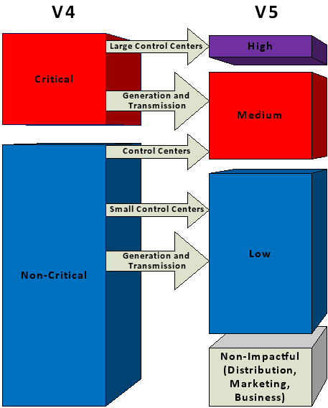
Covered Assets
High Impact
Large Control Centers
CIP-003 through 009+
Medium Impact
Generation and Transmission
Other Control Centers
Similar to CIP-003 to 009 v4
All other Bulk Electric System Cyber Systems
Cyber Security Awareness
Physical Access
Electronic Access
Incident Response
Notes:
Purpose of slide: To pictorially show the change in coverage of assets from Version 4 to the jump in version 5.
Under previous versions, an asset was either critical or not, and the standards then applied fully or not at all. V5 applies impact gradation.
A lot more is captured and given some level of protection through CIP V5 that would have otherwise been classified as non-critical in CIP v4 and prior versions.

Slide 9
Other Developments
Supply Chain
Cloud Computing
Virtualized Technologies
Natural Gas Risk and Vulnerabilities
Insider Threats
Drone and Unmanned Aerial Vehicles
Implementing NERC CIP in Mexico

Slide 10
Questions and Answers

